Slide 1



Toward a Sustainable Agriculture
Module I (Section B): The Big Picture: Systems

Slide 2
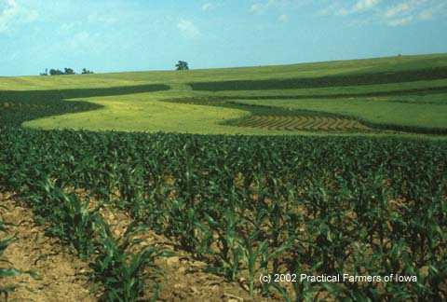
What is a System?
A system is:
A regularly interacting or interdependent group of items forming a unified whole
Module I: The Big Picture: Systems

Slide 3
What is an Ecosystem?
An ecosystem is:
The interactions of energy, living organisms, and the physical environment in a geographic location
Ecosystems:
Get, transform, and waste energy (sunlight, food, fossil fuels…)
Recycle, lose, and get nutrients (nitrogen, phosphorus, potassium, etc.)
Module I: The Big Picture: Systems

Slide 4

Ecosystem
energy
nutrients
organisms
energy
nutrients
energy
organisms
Module I: The Big Picture: Systems

Slide 5
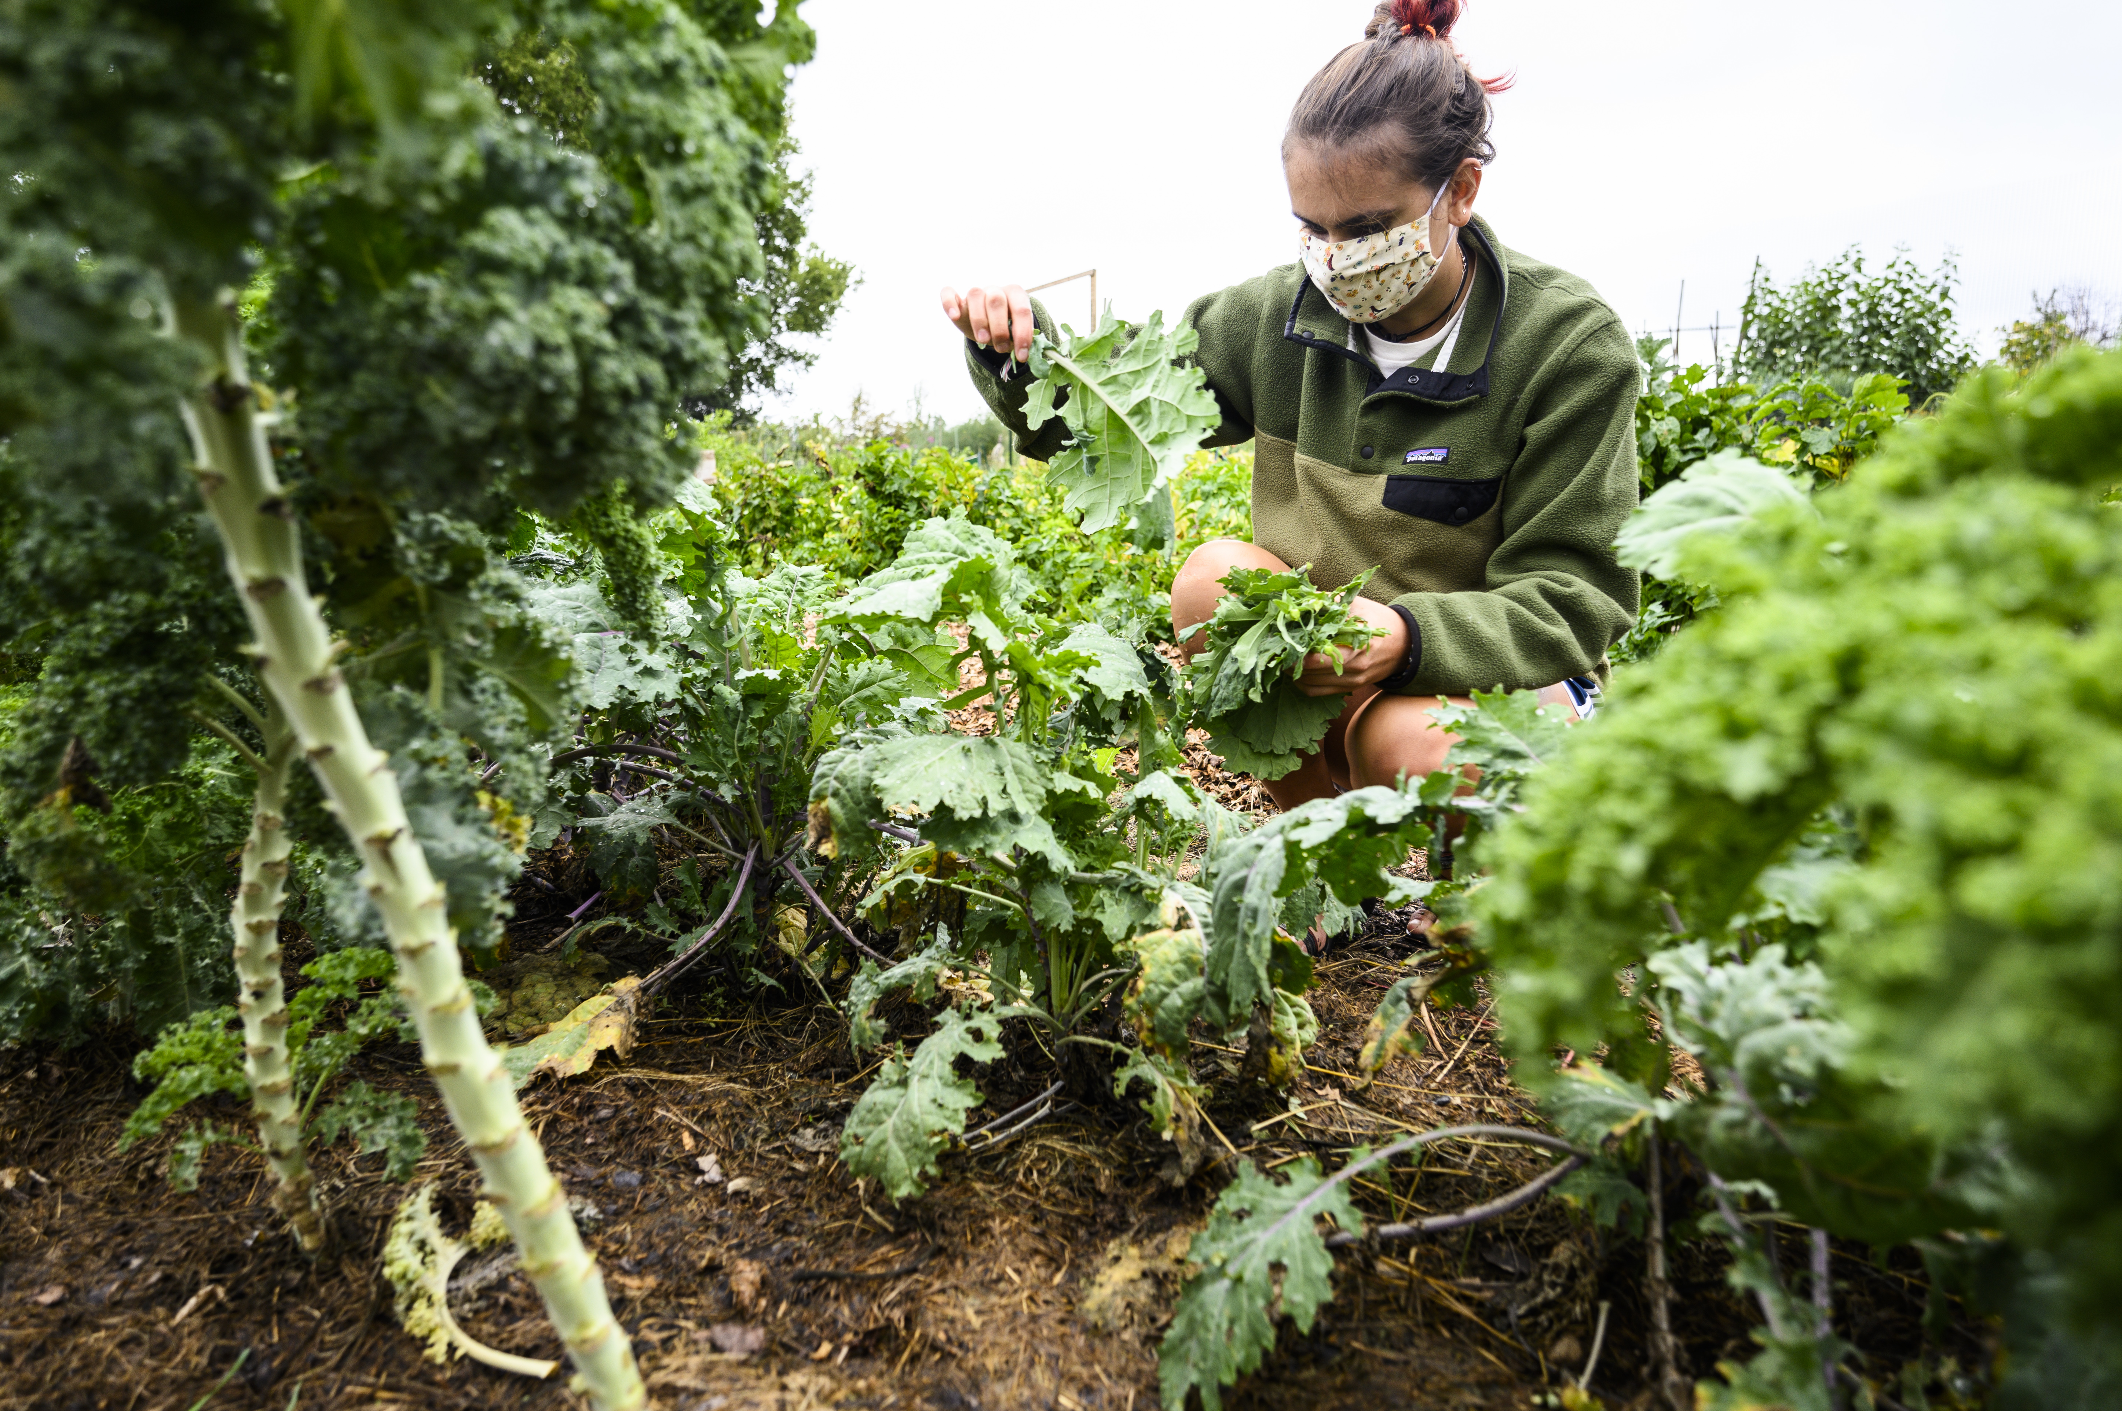
What is an Agro-ecosystem?
An agro-ecosystem is:
An ecosystem that is managed to produce food or fiber
Miller, Jeff. FH_KING_harvest20_9353. Madison, 13 Sept. 2020.
Module I: The Big Picture: Systems

Slide 6

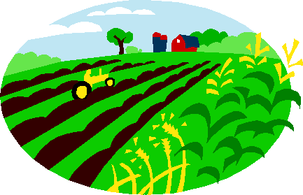


What is a Food System?
A food system is:
The way that food moves from the farm to the consumer
Module I: The Big Picture: Systems

Slide 7

What are the Parts of a Food System?
Production (how the food is grown)
Processing (cleaning, butchering, manufacturing, packaging, cooking, etc.)
Distribution (how the food is moved from the farm to the consumer)
Consumption (how and where the food is consumed)
Waste management (does it go to a landfill? A sewage treatment plant? Back to the farm? Does it pollute?)
Module I: The Big Picture: Systems

