Slide 1


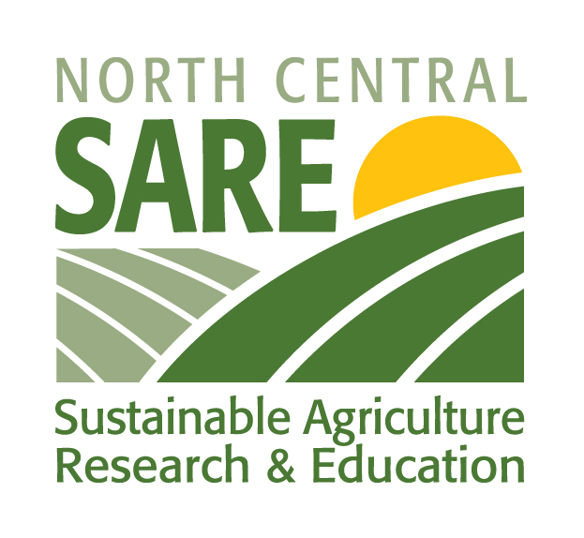
Toward a Sustainable Agriculture
Module I (Section A): Introduction to Sustainable Agriculture
Notes:
No one has figured out the perfect way to farm, and probably no one ever will. So sustainable agriculture involves a continuing search for better ways to produce, process, and distribute food and fiber. Sustainable farmers are always asking what could be improved.

Slide 2
What is Sustainable Agriculture?
1990 Farm Bill: “…an integrated system of plant and animal production practices… that will
  satisfy human food and fiber needs
  enhance environmental quality
  make the most efficient use of nonrenewable resources
  sustain economic viability
  enhance quality of life.”
Module I: Introduction to Sustainable Agriculture
Notes:
This is how sustainable agriculture is defined in the 1990 Farm Bill. It does a good job of capturing the main elements of sustainable agriculture, but it is a little hard to remember the exact wording. See next slide.

Slide 3
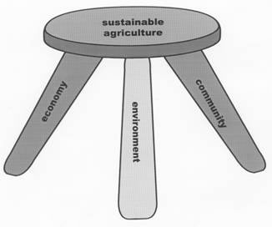
Three-Legged Stool of Sustainability
Module I: Introduction to Sustainable Agriculture
Notes:
The definition of sustainable agriculture that is most widely used is the metaphor of a 3-legged stool. If one of the legs breaks, the whole stool will fall over. This metaphor tells us sustainable agriculture has to address three major areas: economics, the environment, and social factors or community.

Slide 4

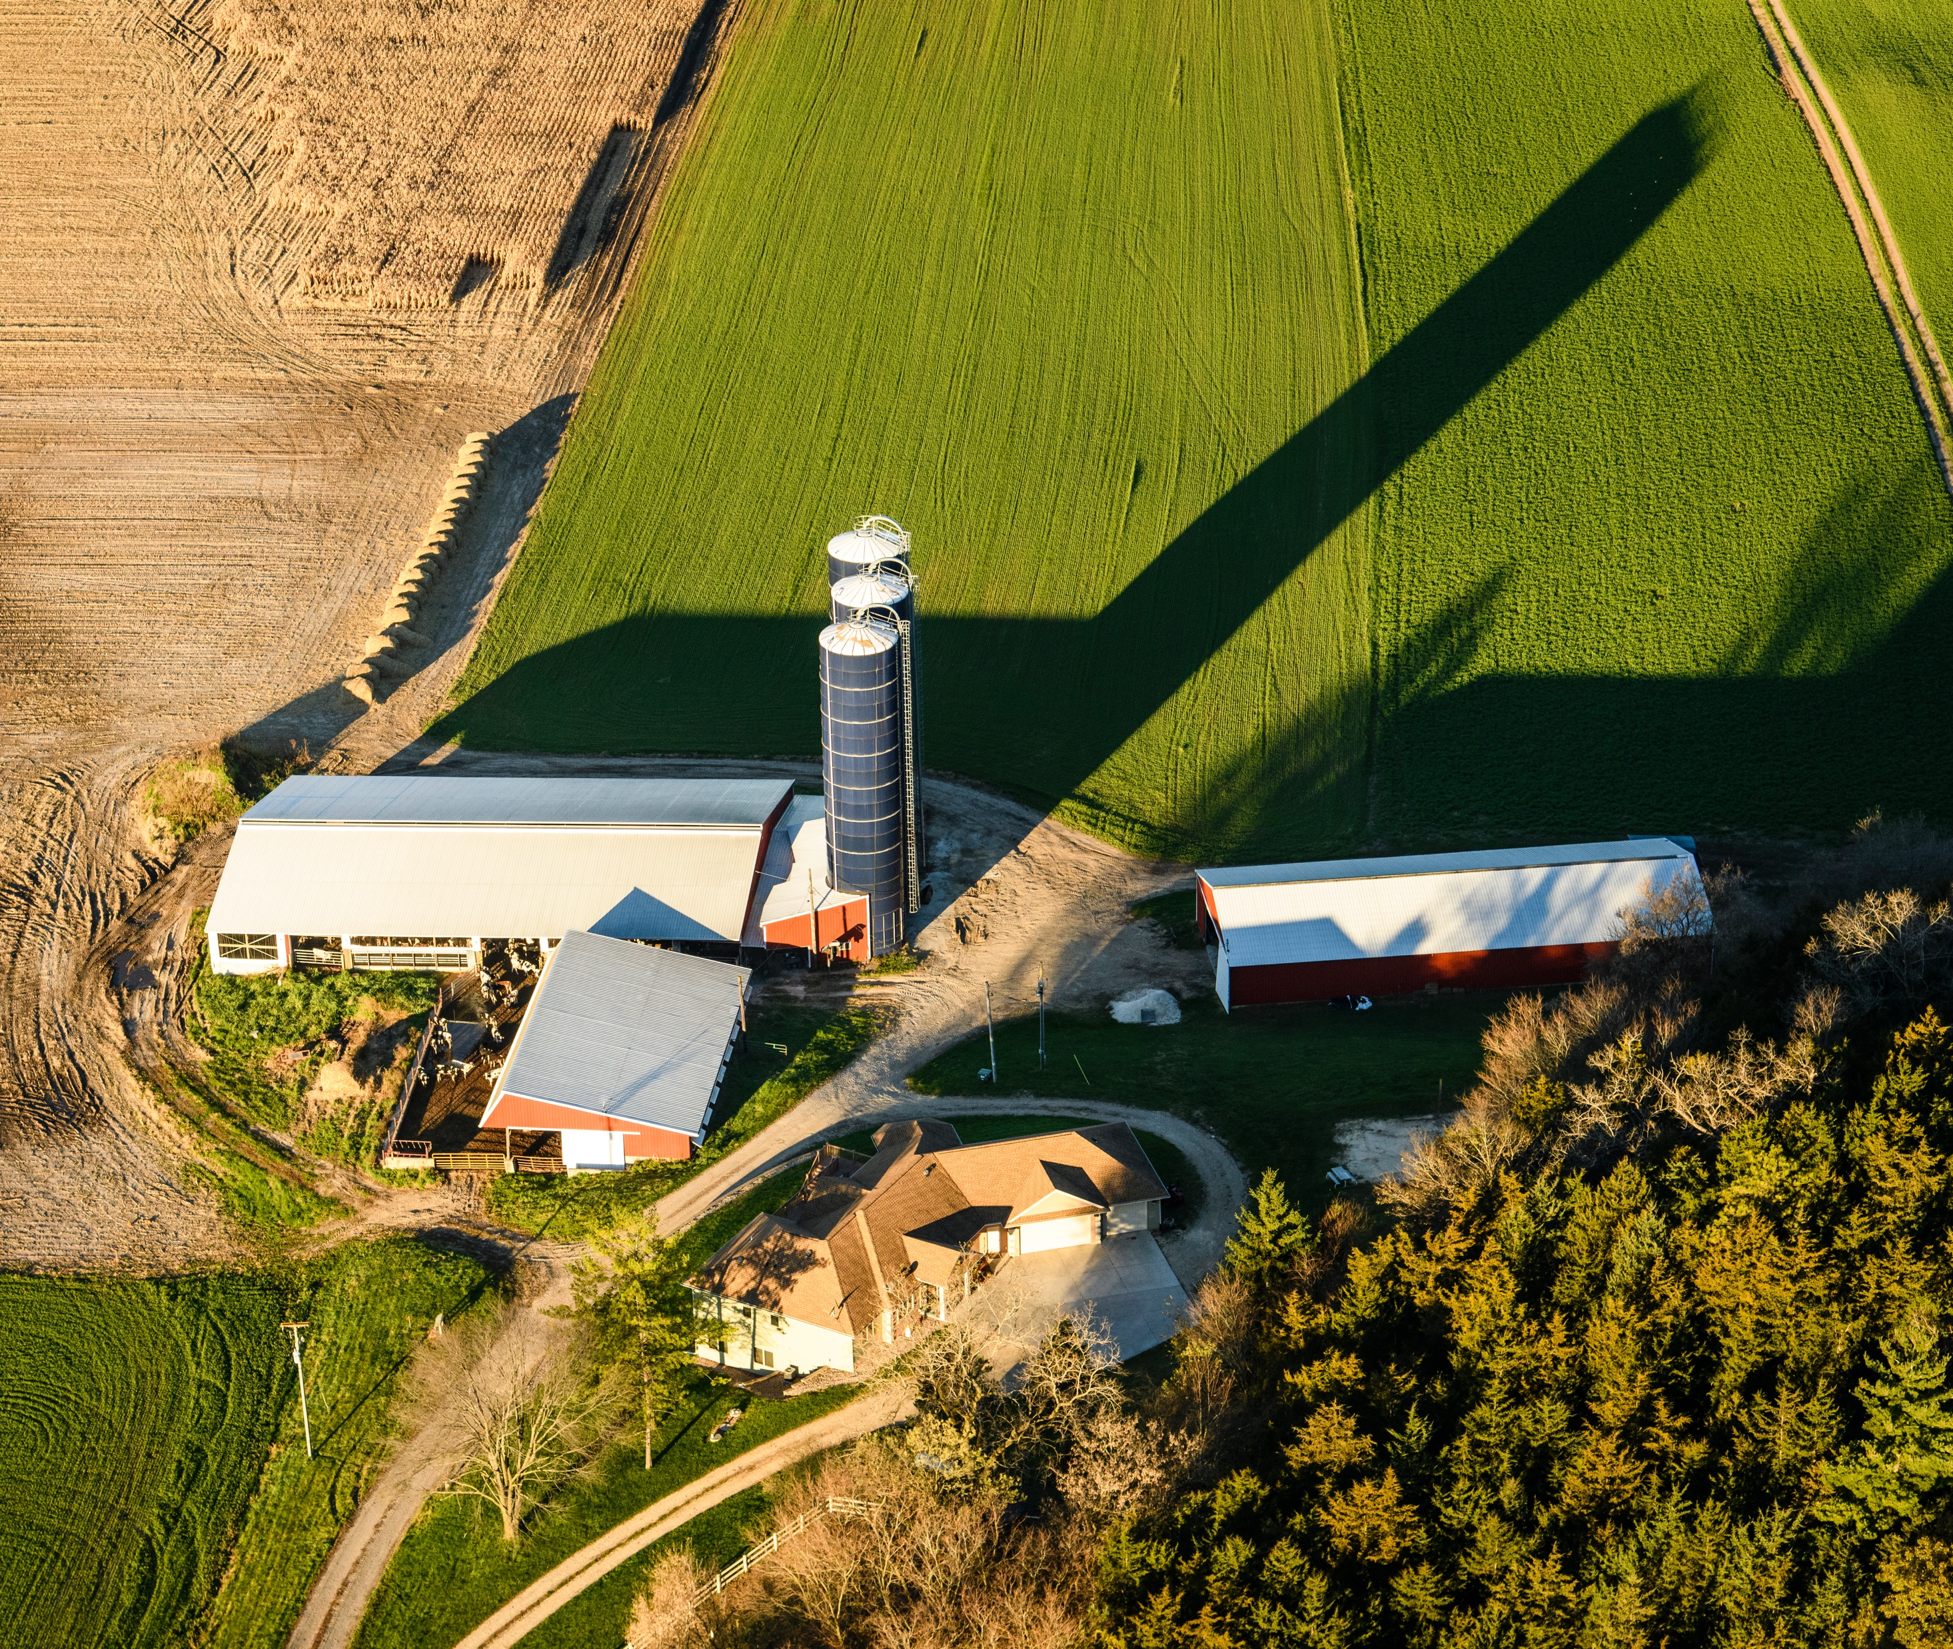
What is Economically Sustainable?
Provides a secure living for farm families
Provides a secure living to other workers in the food system
Richter, Bryce. Aerial_Wis_Farmland18_0730. Baraboo, 23 Oct. 2018.
Module I: Introduction to Sustainable Agriculture
Notes:
What do we mean when we say sustainable agriculture has to be economically sustainable? At a minimum, individual farms have to be profitable, or they will not last long. But agriculture encompasses more than just farms. Economic sustainability also suggests that agriculture must provide and deliver food and fiber to the public.

Slide 5
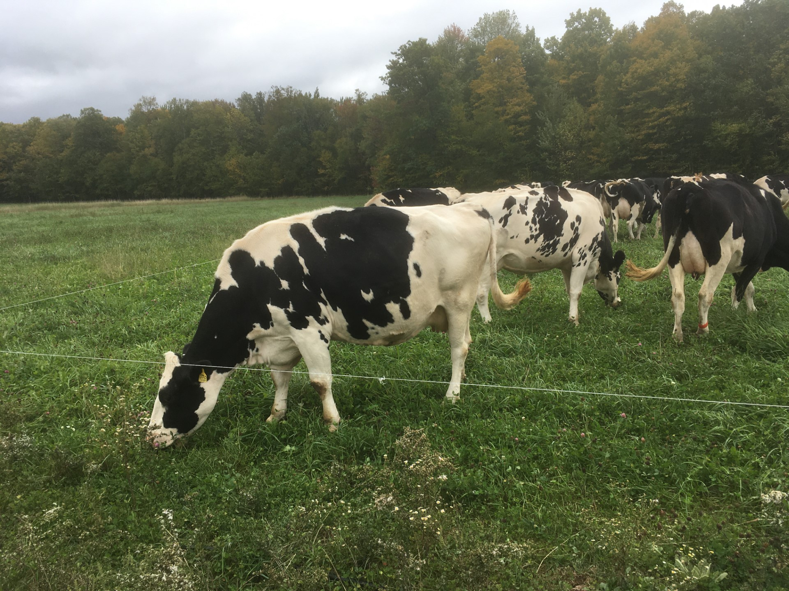
What is Environmentally Sound?
Environmentally sound preserves the:
  Quality of soil, water, and air
  Cooperates with and is modeled on natural systems
Module I: Introduction to Sustainable Agriculture
Notes:
At a minimum, environmental sustainability means the preservation of the natural resources upon which agriculture depends.
Rather than trying to patch pollution problems one by one, sustainable agriculture tries to design a system that avoids polluting and depleting natural resources to begin with.

Slide 6
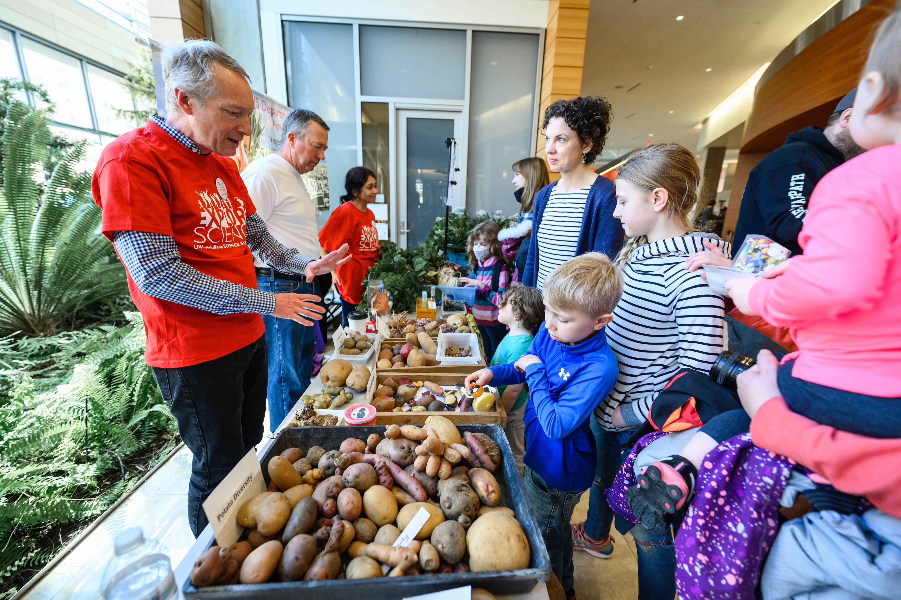

What is Socially Sustainable?
Socially Sustainable is:
  Good for families
  Supports communities
  Fair to all involved
Provides access to good food for all
Dotzour, Althea. _AD14595. Madison, 9 Apr. 2022.
Module I: Introduction to Sustainable Agriculture
Notes:
A sustainable agriculture has to be good for people as well as the land and business.

Slide 7
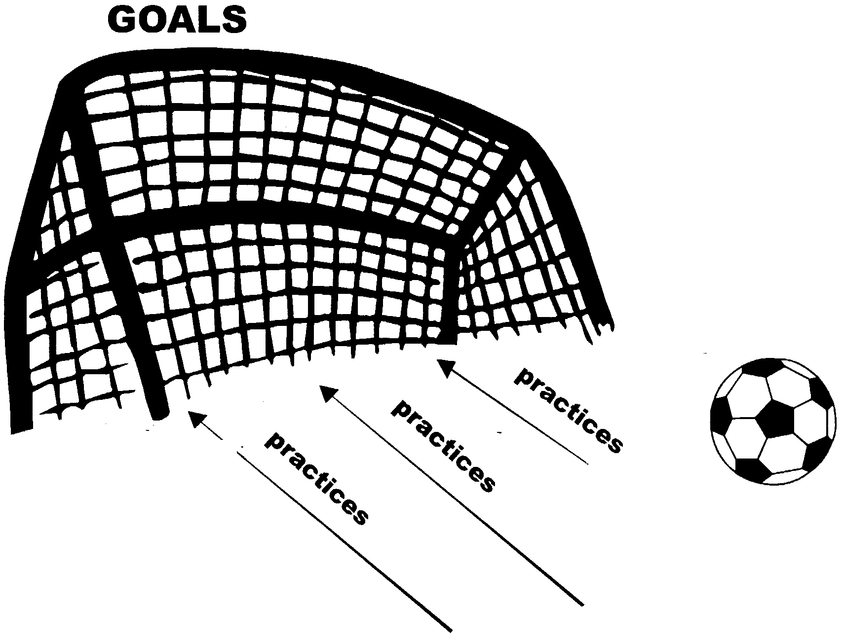
What is the Difference Between Goals and Practices?
Goals: A desired end
Practices: Actions to achieve a goal
Module I: Introduction to Sustainable Agriculture
Notes:
Profitable economics, healthy environment, and vital communities are all goals. They are what we are trying to achieve. Practices are actions we take to achieve those goals. Why don’t we define sustainable agriculture in terms of practices? There are two important reasons: First, we expect that our knowledge will increase in the future, so practices used now may not be considered the best practices ten years from now. Second, the effect of a practice can vary enormously depending on how and where it is performed. For example, plowing on a steep hillside is unsustainable because it causes too much soil erosion. However, occasional plowing on level ground can be a sustainable tool for some cropping systems.

Slide 8

How do you Achieve your Goals?
Figure out where you are
Analyze your strengths and weaknesses
Select strategies (practices)
Keep monitoring your progress
Re-evaluate your goals and plans
Module I: Introduction to Sustainable Agriculture

Slide 9
What are the Strengths of the Food System?
abundant food supply in the developed world
fresh fruits and vegetables available year-round
cheap food
luxury foods such as coffee, tea, chocolate, and spices easily available around the world
effective food preservation technologies (refrigeration, freezing, canning, packaging)
convenience foods
mechanization produces high labor efficiency
improvements in soil conservation
availability of agricultural inputs for quick solutions to production problems
Module I: Introduction to Sustainable Agriculture

Slide 10
What are the Weaknesses of the Food System?
continuing soil loss​
food safety concerns (animal-borne disease, food poisoning outbreaks, antibiotic resistance, toxins and pesticides)​
water pollution, air pollution (& odors), habitat loss, water depletion​
continuing hunger – and rising diet-related disease (diabetes, etc.) ​
failing farms, economic uncertainty, and stress​
rural population loss​
farm accidents, chronic diseases linked to agricultural chemicals​
reliance on fossil fuels, global warming​
farmland loss to development, ugly countryside​
difficulty of starting in farming
Module I: Introduction to Sustainable Agriculture

Slide 11
Conclusion
Agriculture has accomplished much
There are still many problems to solve, both old and new
Sustainable agriculture is about trying to solve these problems – without creating new ones.
Module I: Introduction to Sustainable Agriculture

